Slide 1


Day 30
contact@anubhavtrainings.com
ABAP RESTFUL APPLICATION PROGRAMMING

Slide 2

Agenda – Day 30
Create CDS View for Approver
Implementation of Behaviour Definition
Create Service Definition to Expose Entity
Create Service Binding
What is Action ?
Why we need Action
Types of Action
How to Use Action in RAP

Slide 3
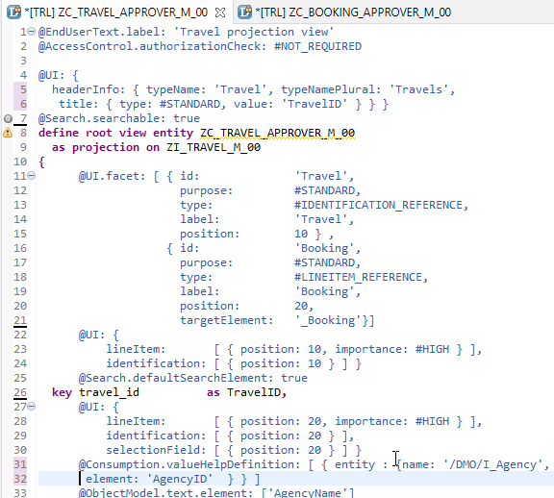
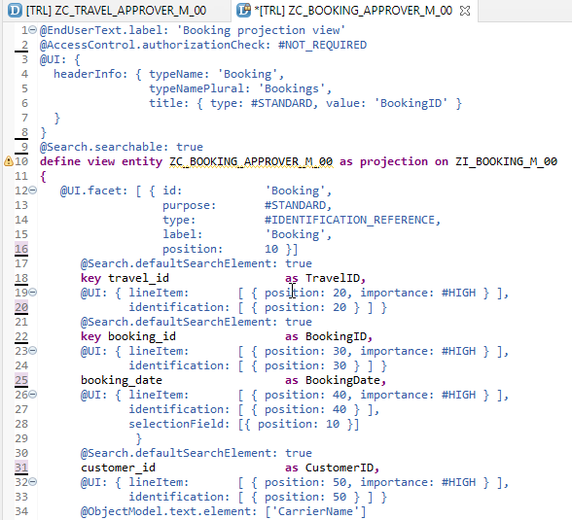
Create CDS View’s for Approver
Projection CDS View for Travel Info “ZC_TRAVEL_APPROVER_M_00”
Projection CDS View for Booking Info “ZC_BOOKING_APPROVER_M_00”

Slide 4
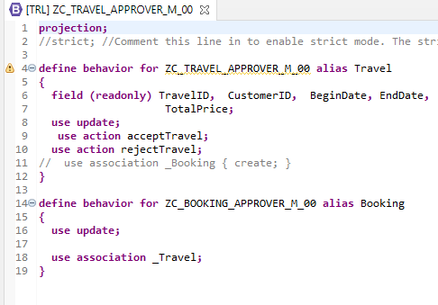
Implementing Behaviour Definition
“ZC_TRAVEL_APPROVER_M_00”
Behavior Definition for Projection CDS’s Views of Processor.

Slide 5
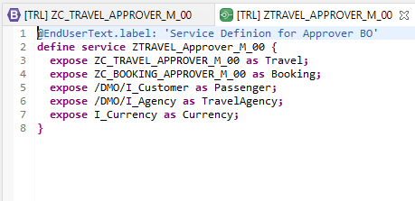
Service Definition
“ZTRAVEL_APPROVER_M_00”
Service Definition for Expose Entity

Slide 6
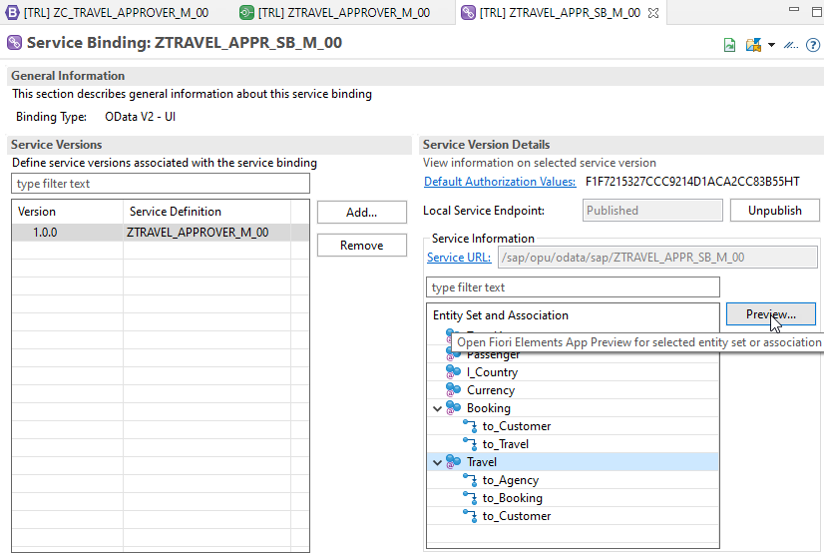
Service Binding
After Creating Service Binding , Select Entity and Click on Preview

Slide 7
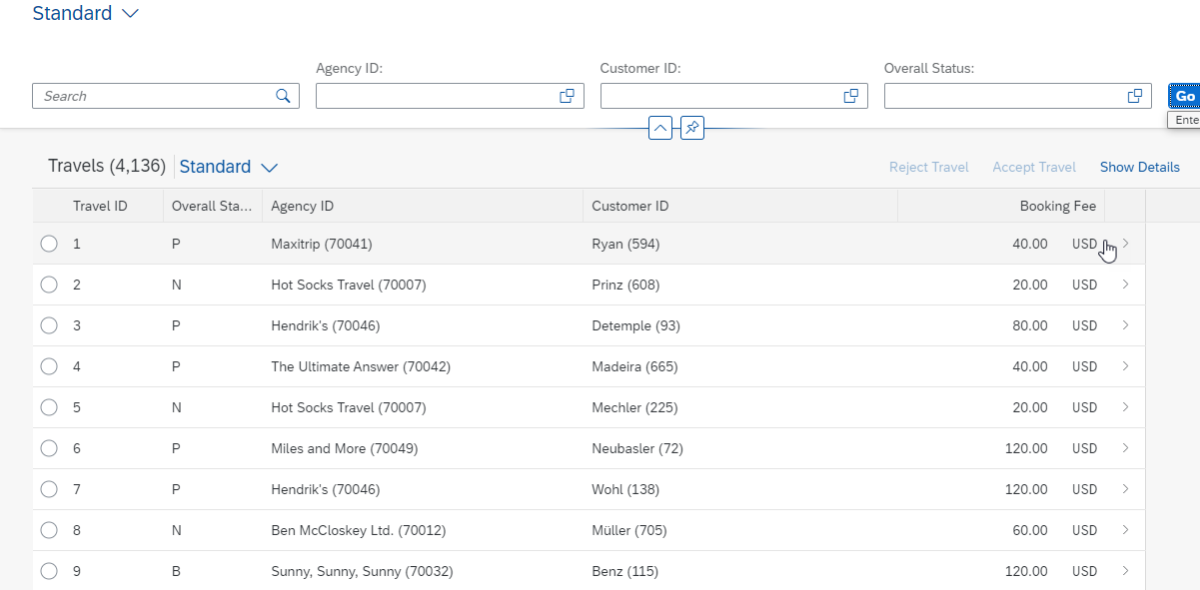
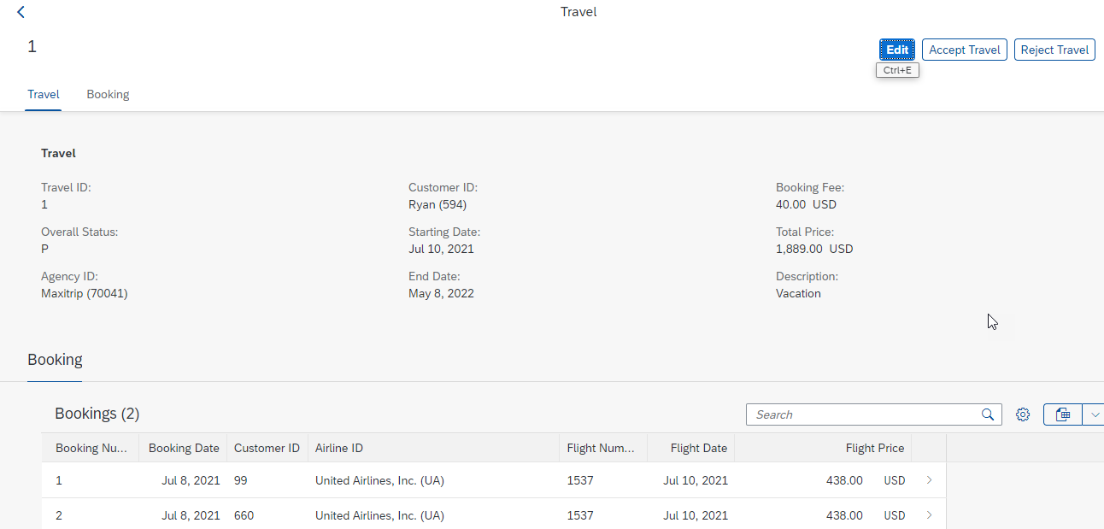
Final Result for Approver App
1st Screen with Search Bar & Filter Bar
2nd Screen with Travel and Booking Data,
& Approve or Reject Functionality

Slide 8
What is SAP HANA?

Slide 9
What is SAP HANA?

Slide 10
What is SAP HANA?

Slide 11
What is SAP HANA?

Slide 12
What is SAP HANA?

Slide 13
What is SAP HANA?

Slide 14
What is SAP HANA?

Slide 15
What is SAP HANA?

Slide 16
What is SAP HANA?

Slide 17
What is SAP HANA?

Slide 18
What is SAP HANA?

Slide 19

End of Day 30
Trainer: Anubhav Oberoy

Slide 20

Trainer: Anubhav Oberoy

Slide 21
THANK YOU
If you cannot do
great things, do small things in a great way.
Anubhav Oberoy
https://www.anubhavtrainings.com

Slide 22


We’re committed to empower you to be
Most Desirable Resource
through powerful training solutions.
We build the workforce of the future.
250+
Corporate Clients
30,000+
Learners Trained
25000+
Learners Placed
FREE WEBINARS
Sign up for free webinars with industry experts every fortnight!
Enroll Now!
Contact us today!
https://anubhavtrainings.com/

Slide 23




More from AnubhavTrainings.com

